Slide 1

A course project presentation
on
MEASURING LIGHT INTENSITY USING ESP8266 MODULE
By
B. SAI CHARAN 2203A51L72
P. CHANDHANA 2203A51L47
B. SUSHMITHA 2203A51L82
MD. SHAHNAWAZ 2203A51L87
21CS116 - Internet of Things
School of Computer Science and Artificial Intelligence

Slide 2
TITLE OF THE PROJECT:
MEASURING LIGHT INTENSITY USING ESP8266 MODULE

Slide 3
CONTENTS
Abstract
Objective
Definitions of Elements
Software
Connectivity / Hardware Architecture
Testing
Conclusion

Slide 4
ABSTRACT
In this project, we present the development and deployment of a light detection system utilizing a photoresistor integrated with NodeMcu (ESP8266) microcontroller.
The primary objective is to accurately measure the intensity of light in the surrounding environment and provide real-time feedback based on the detected light level.
The system is designed to offer a cost-effective and efficient solution for various applications including smart home automation, security systems, and environmental monitoring.
The hardware architecture comprises a photoresistor as the light sensor and NodeMcu (ESP8266) as the main processing unit.

Slide 5
Develop and deploy a light detection system using a photoresistor integrated with NodeMcu (ESP8266) microcontroller.
Aim to accurately measure light intensity in the surrounding environment and provide real-time feedback based on the detected light level.
Target various applications including smart home automation, security systems, and environmental monitoring.
OBJECTIVE

Slide 6
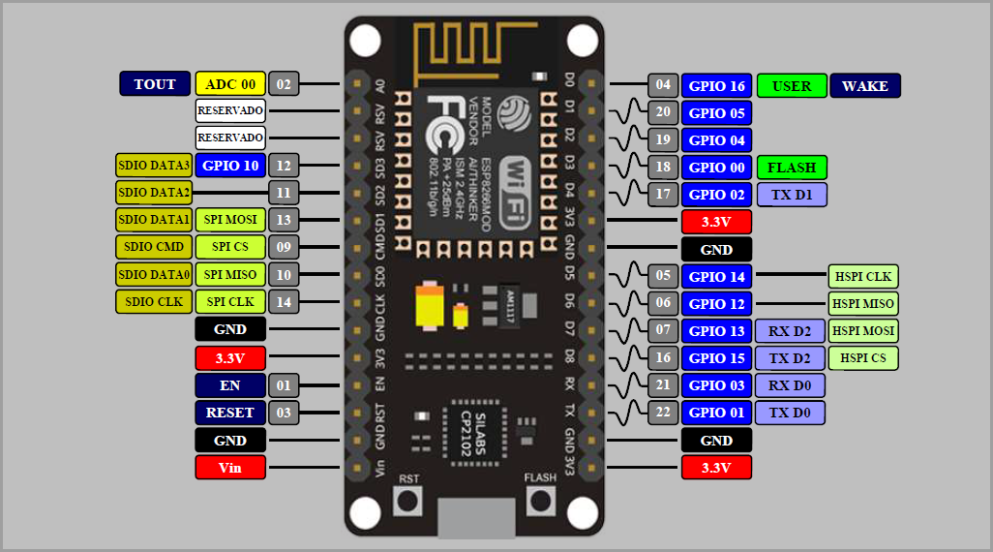
DEFINATIONS OF ELEMENTS
1. ESP8266 Wi-Fi Module:

Slide 7
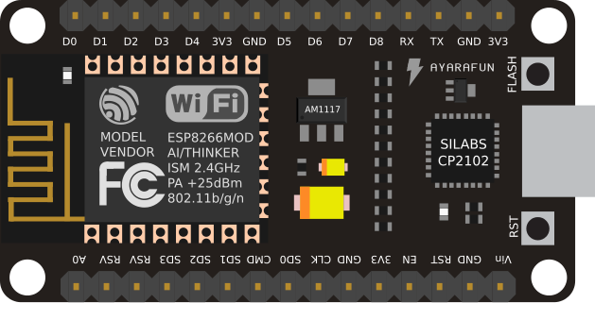
What is ESP8266 Module?
NodeMCU ESP8266 is a development board and open-source firmware that allows users to prototype or build IoT products.
It has firmware that runs on the ESP8266 Wi-Fi SoC from Espressif Systems, and hardware based on the ESP-12 module.
The firmware uses the Lua scripting language and C++ language.
NodeMCU is a low-cost IoT platform that provides a cost-effective way to connect devices to the internet.
It has Wi-Fi and programming capabilities, which allows for speedy prototyping and deployment of IoT solutions.

Slide 8
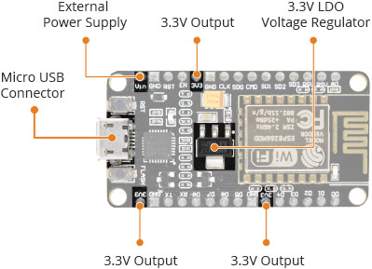
SPECIFICATIONS OF ESP8266 MODULE:
Size: 49mm x 26mm
Pin spacing: 0.9" (22.86mm)
Operating voltage: 3.3V
Input voltage: 4.5V-10V
Flash memory/SRAM: 4 MB / 64 KB
Digital I/O pins: 11
Analog In pins: 1
ADC range: 0-3.3V

Slide 9
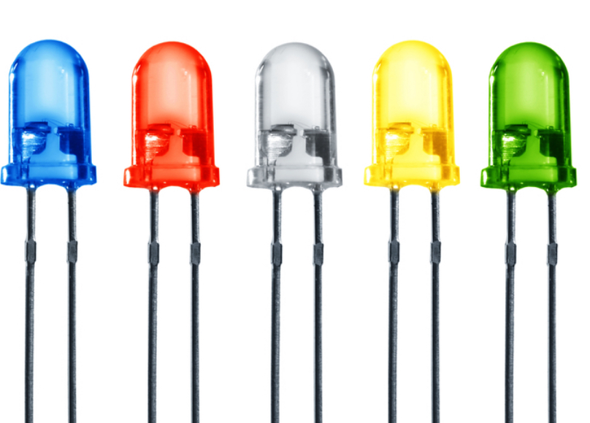
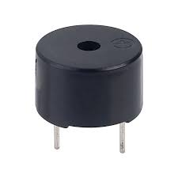
2. LED’S:
A light-emitting diode is a semiconductor device that emits light when current flows through it.
Electrons in the semiconductor recombine with electron holes, releasing energy in the form of photons.
The color of the light is determined by the energy required for electrons to cross the band gap of the semiconductor.
3. BUZZER:
A buzzer or beeper is an audio signaling device, which may be mechanical, electromechanical, or piezoelectric (piezo for short).
Typical uses of buzzers and beepers include alarm devices, timers, train and confirmation of user input such as a mouse click or keystroke.

Slide 10
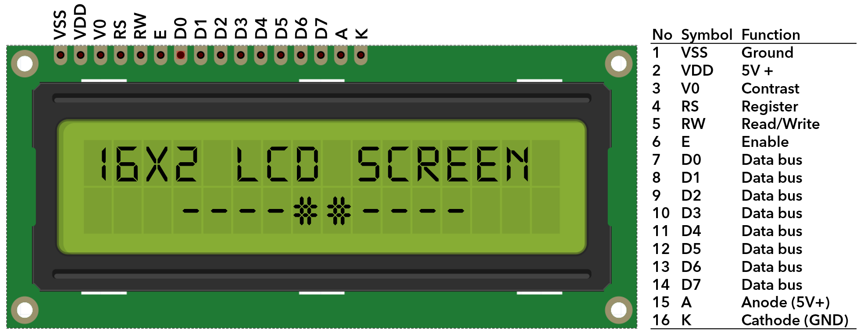
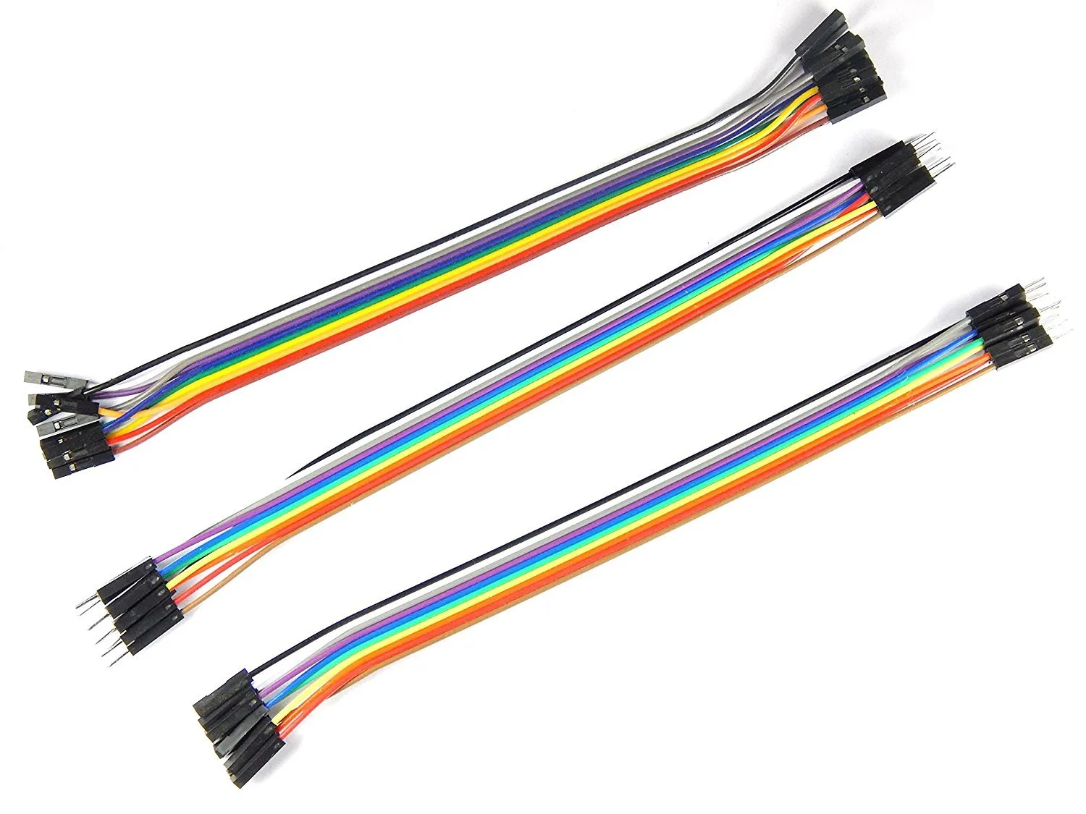
4. LCD DISPLAY:
A 16×2 LCD display is a liquid crystal display that can show 16 characters in each of its two rows, providing a total of 32 characters of information.
It's commonly used to display alphanumeric information in various electronic devices.
The operating voltage of this LCD is 4.7V-5.3V
It includes two rows where each row can produce 16-characters.
5. JUMPER WIRES:
A jump wire is an electrical wire, or group of them in a cable, with a connector or pin at each end (or sometimes without them – simply "tinned")
which is normally used to interconnect the components of a breadboard or other prototype or test circuit, internally.

Slide 11
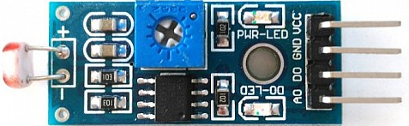
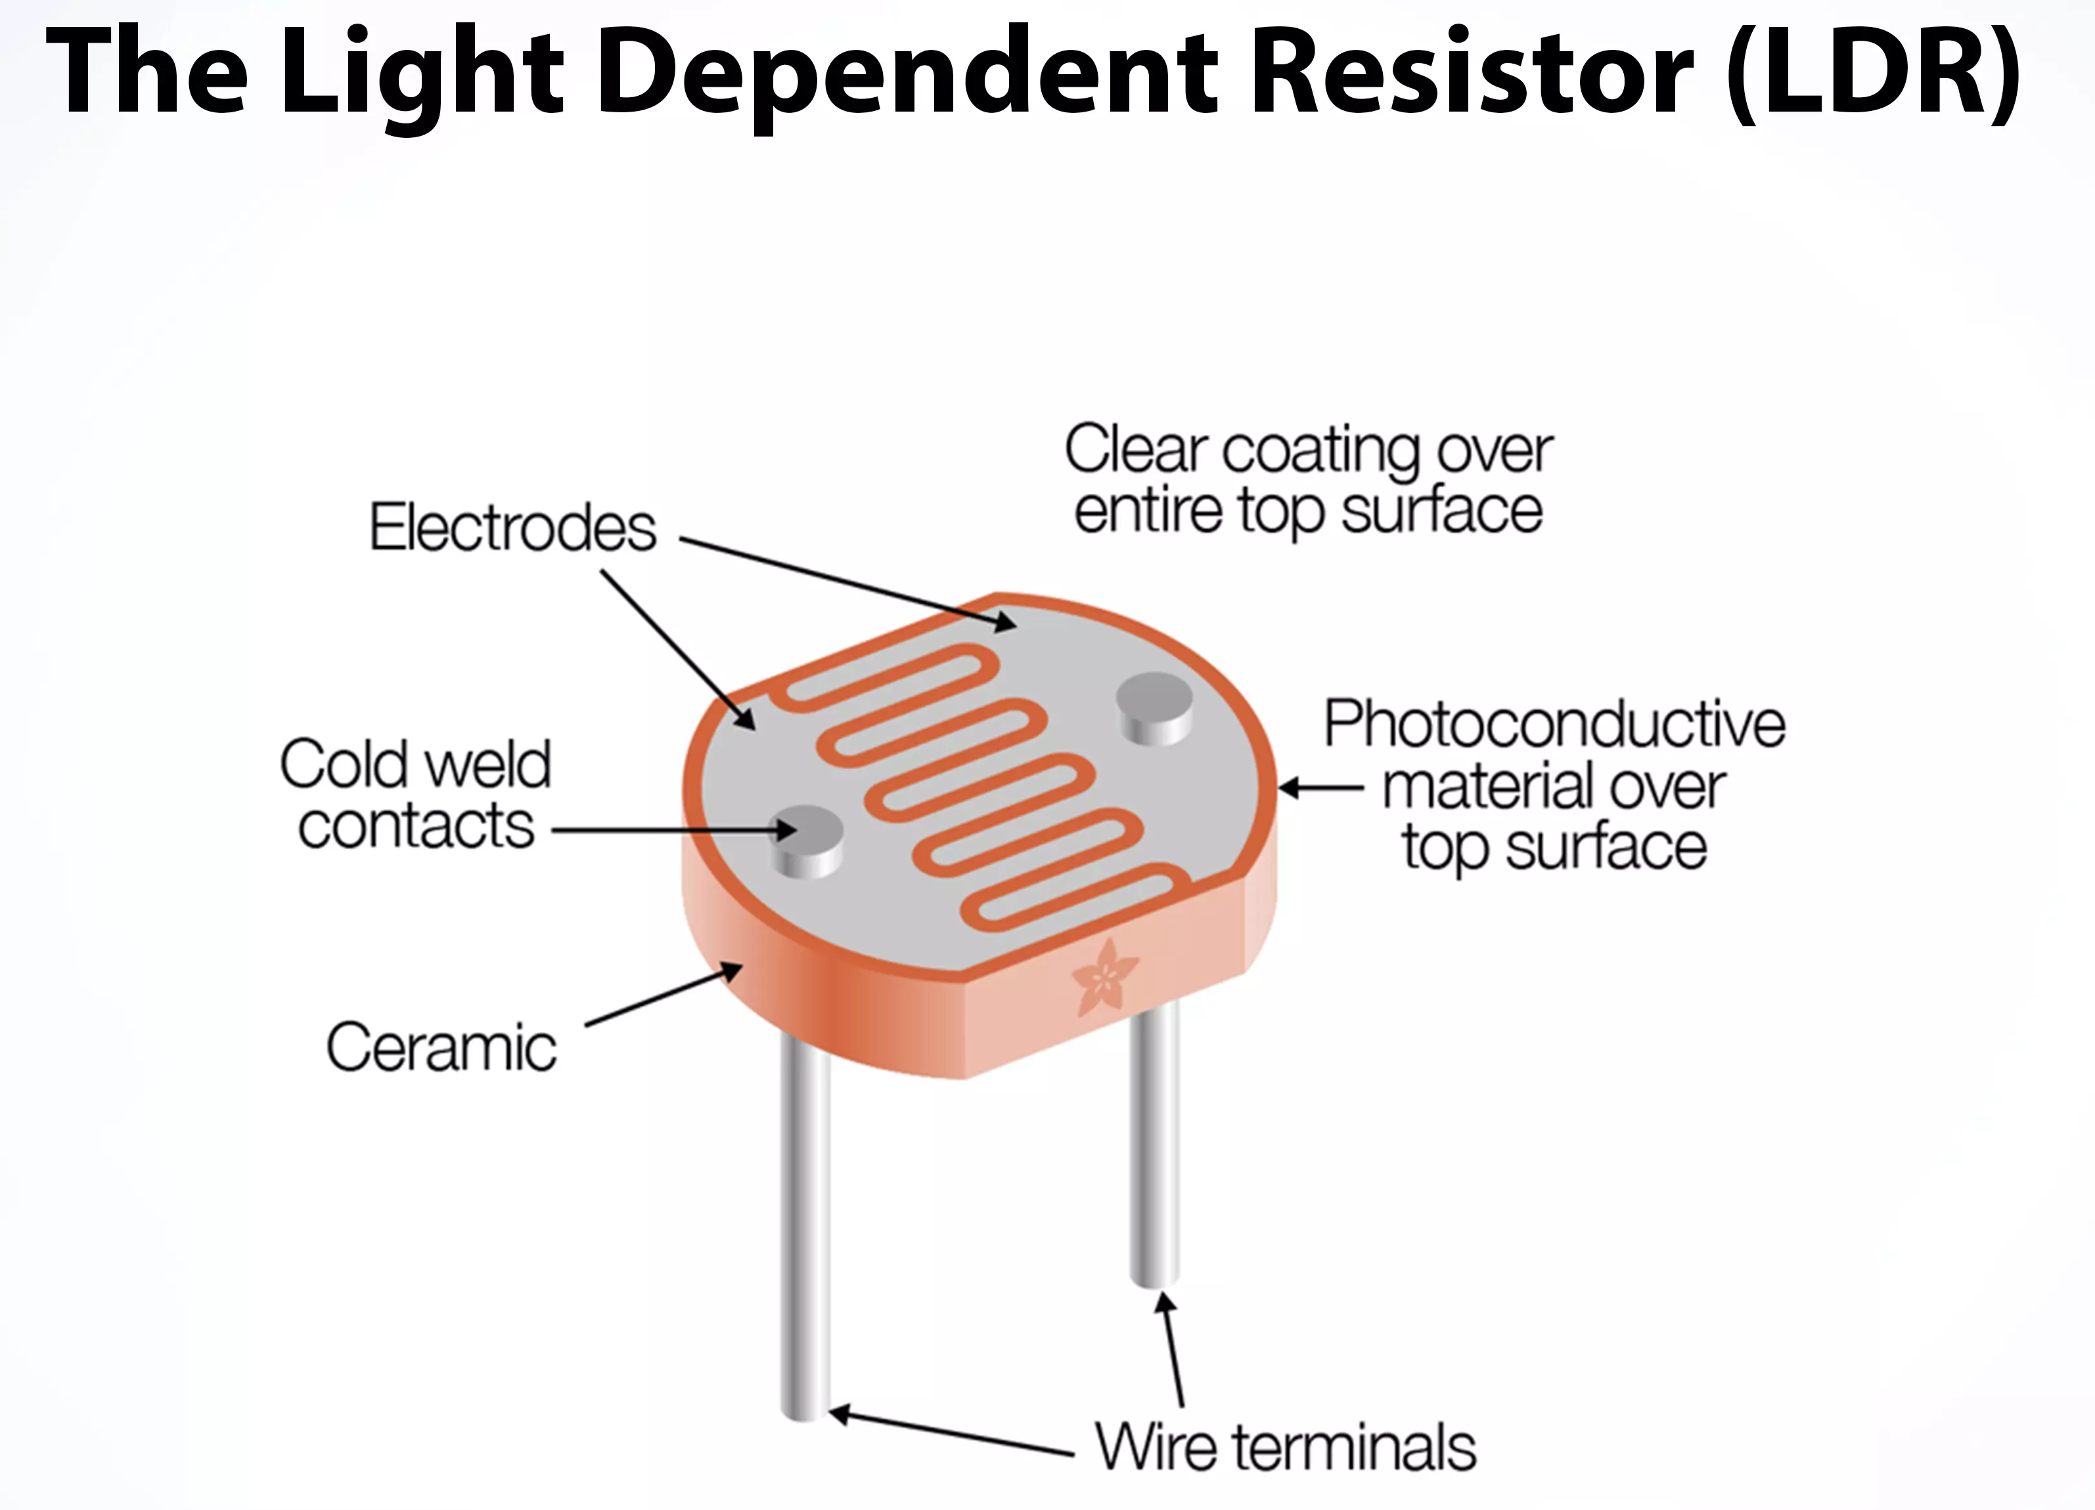
6. PHOTO RESISTOR (LDR) SENSOR:
A Light Dependent Resistor (LDR) is a type of passive electronic sensor used to detect light.
It's made up of two conductors separated by an insulator which becomes more conducting when exposed to high levels of light intensity, forming a variable resistor in the circuit.
Working Principle of LDR: The photo conductivity theory underlies the operation of this resistor. It is nothing more than the fact that when light strikes its surface, the material's conductivity decreases and the electrons in the device's valence band are stimulated to the conduction band.

Slide 12

SOFTWARE USED:
1. Arduino IDE:
The Arduino IDE (Integrated Development Environment) is used to write the computer code and upload this code to the physical board.
The Arduino IDE is very simple and this simplicity is probably one of the main reason Arduino became so popular.
We can certainly state that being compatible with the Arduino IDE is now one of the main requirements for a new microcontroller board.
Over the years, many useful features have been added to the Arduino IDE and you can now managed third-party libraries and boards from the IDE, and still keep the simplicity of programming the board.

Slide 13
Here's some information about it:
Development Environment: The Arduino IDE provides a user-friendly interface for writing code in the Arduino programming language, which is a simplified version of C/C.
Cross-Platform: Arduino IDE is available for multiple operating systems, including Windows, macOS, and Linux, making it accessible to a wide range of users.
Code Editor: The IDE features a code editor with syntax highlighting, auto-indentation, and code completion, making it easier to write and read code.
Library Support: Arduino IDE comes with a built-in library manager that allows users to easily install and manage libraries, which are collections of pre-written code that extend the functionality of Arduino boards.
Board Manager: It includes a board manager feature that enables users to add support for different Arduino-compatible boards, such as Arduino Uno, Arduino Mega, Arduino Nano, etc. This feature allows developers to switch between different boards without needing to install separate software.
Serial Monitor: Arduino IDE includes a serial monitor tool that allows users to communicate with their Arduino boards in real-time, which is useful for debugging and testing.

Slide 14

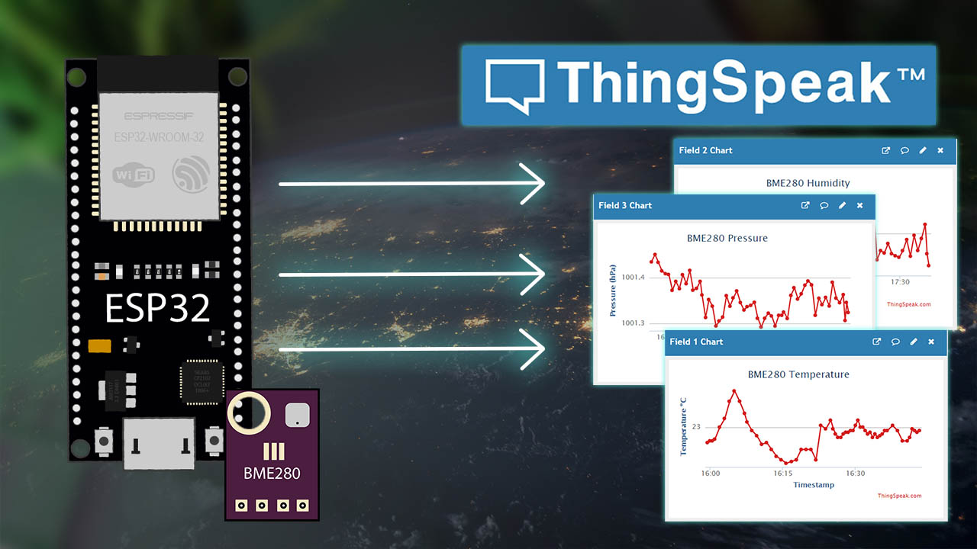
2. ThingSpeak
ThingSpeak is an open-source software written in Ruby which allows users to communicate with internet enabled devices.
It facilitates data access, retrieval and logging of data by providing an API to both the devices and social network websites.
ThingSpeak allows you to aggregate, visualize, and analyze live data streams in the cloud.
ThingSpeak provides instant visualizations of data posted by your devices or equipment.
Execute MATLAB code in ThingSpeak, and perform online analysis and processing of the data as it comes in.

Slide 15
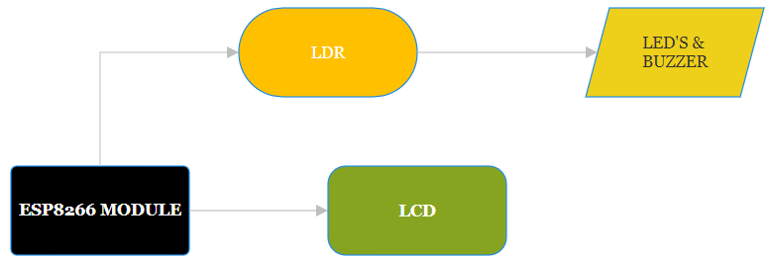
HARDWARE ARCHITECTURE / CONNECTIVITY:
To implement a system using the ESP8266 module to measure light intensity and display it on an LCD, along with additional indicators like a buzzer and LEDs, you would follow these general steps:
Hardware Setup:
Connect the ESP8266 module to the LCD display, buzzer, and LEDs according to their pin configurations.
Connect a light sensor (such as an LDR - Light Dependent Resistor) to one of the analog pins of the ESP8266 to measure light intensity.

Slide 16
2. Programming:
Initialize the ESP8266 module and configure it to connect to your Wi-Fi network.
Initialize the LCD display and configure it to show the light intensity and any additional information.
Set up the buzzer and LEDs as output pins.
Continuously read the light intensity from the light sensor.
Based on the light intensity readings:
If the intensity is high, display a message on the LCD, turn on the green LED, and trigger the buzzer.
If the intensity is low, display a different message on the LCD, turn on the red LED, and turn off the buzzer.
Update the LCD display with the current light intensity value and any additional information.

Slide 17
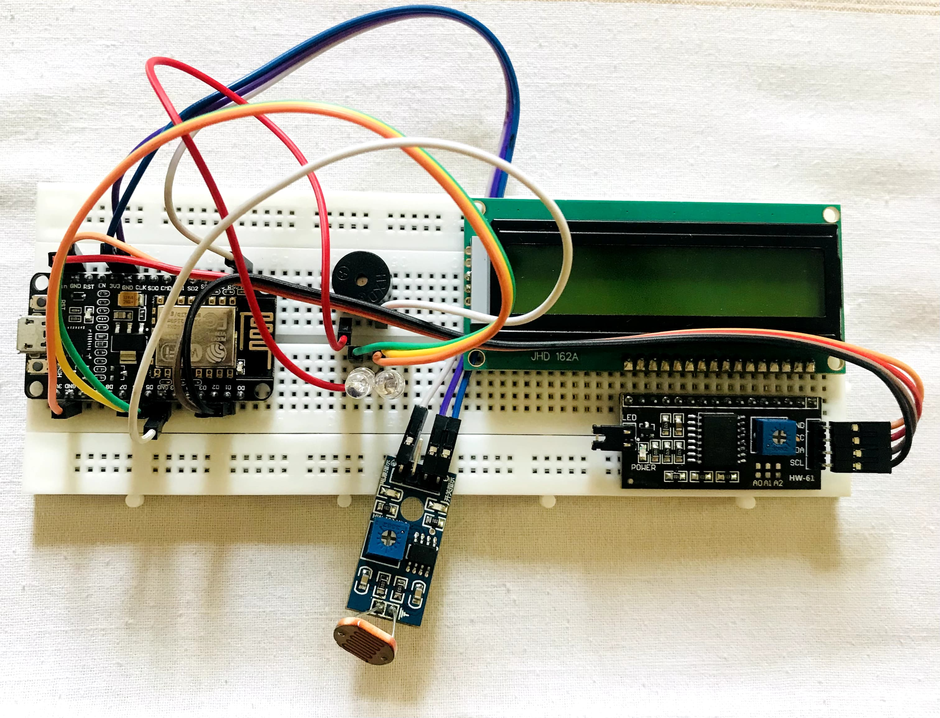
TESTING:
Connect the Micro USB to the Laptop or Power Bank.
Make sure the LCD is on.
Turn on the Mobile’s Hotspot.
Wait until the module connects to the Wi-Fi.
After successful connection the LCD shows the Intensity and LED glows indicating LOW/HIGH.
Buzzer will make beep sound when intensity is High that is above 50.

Slide 18
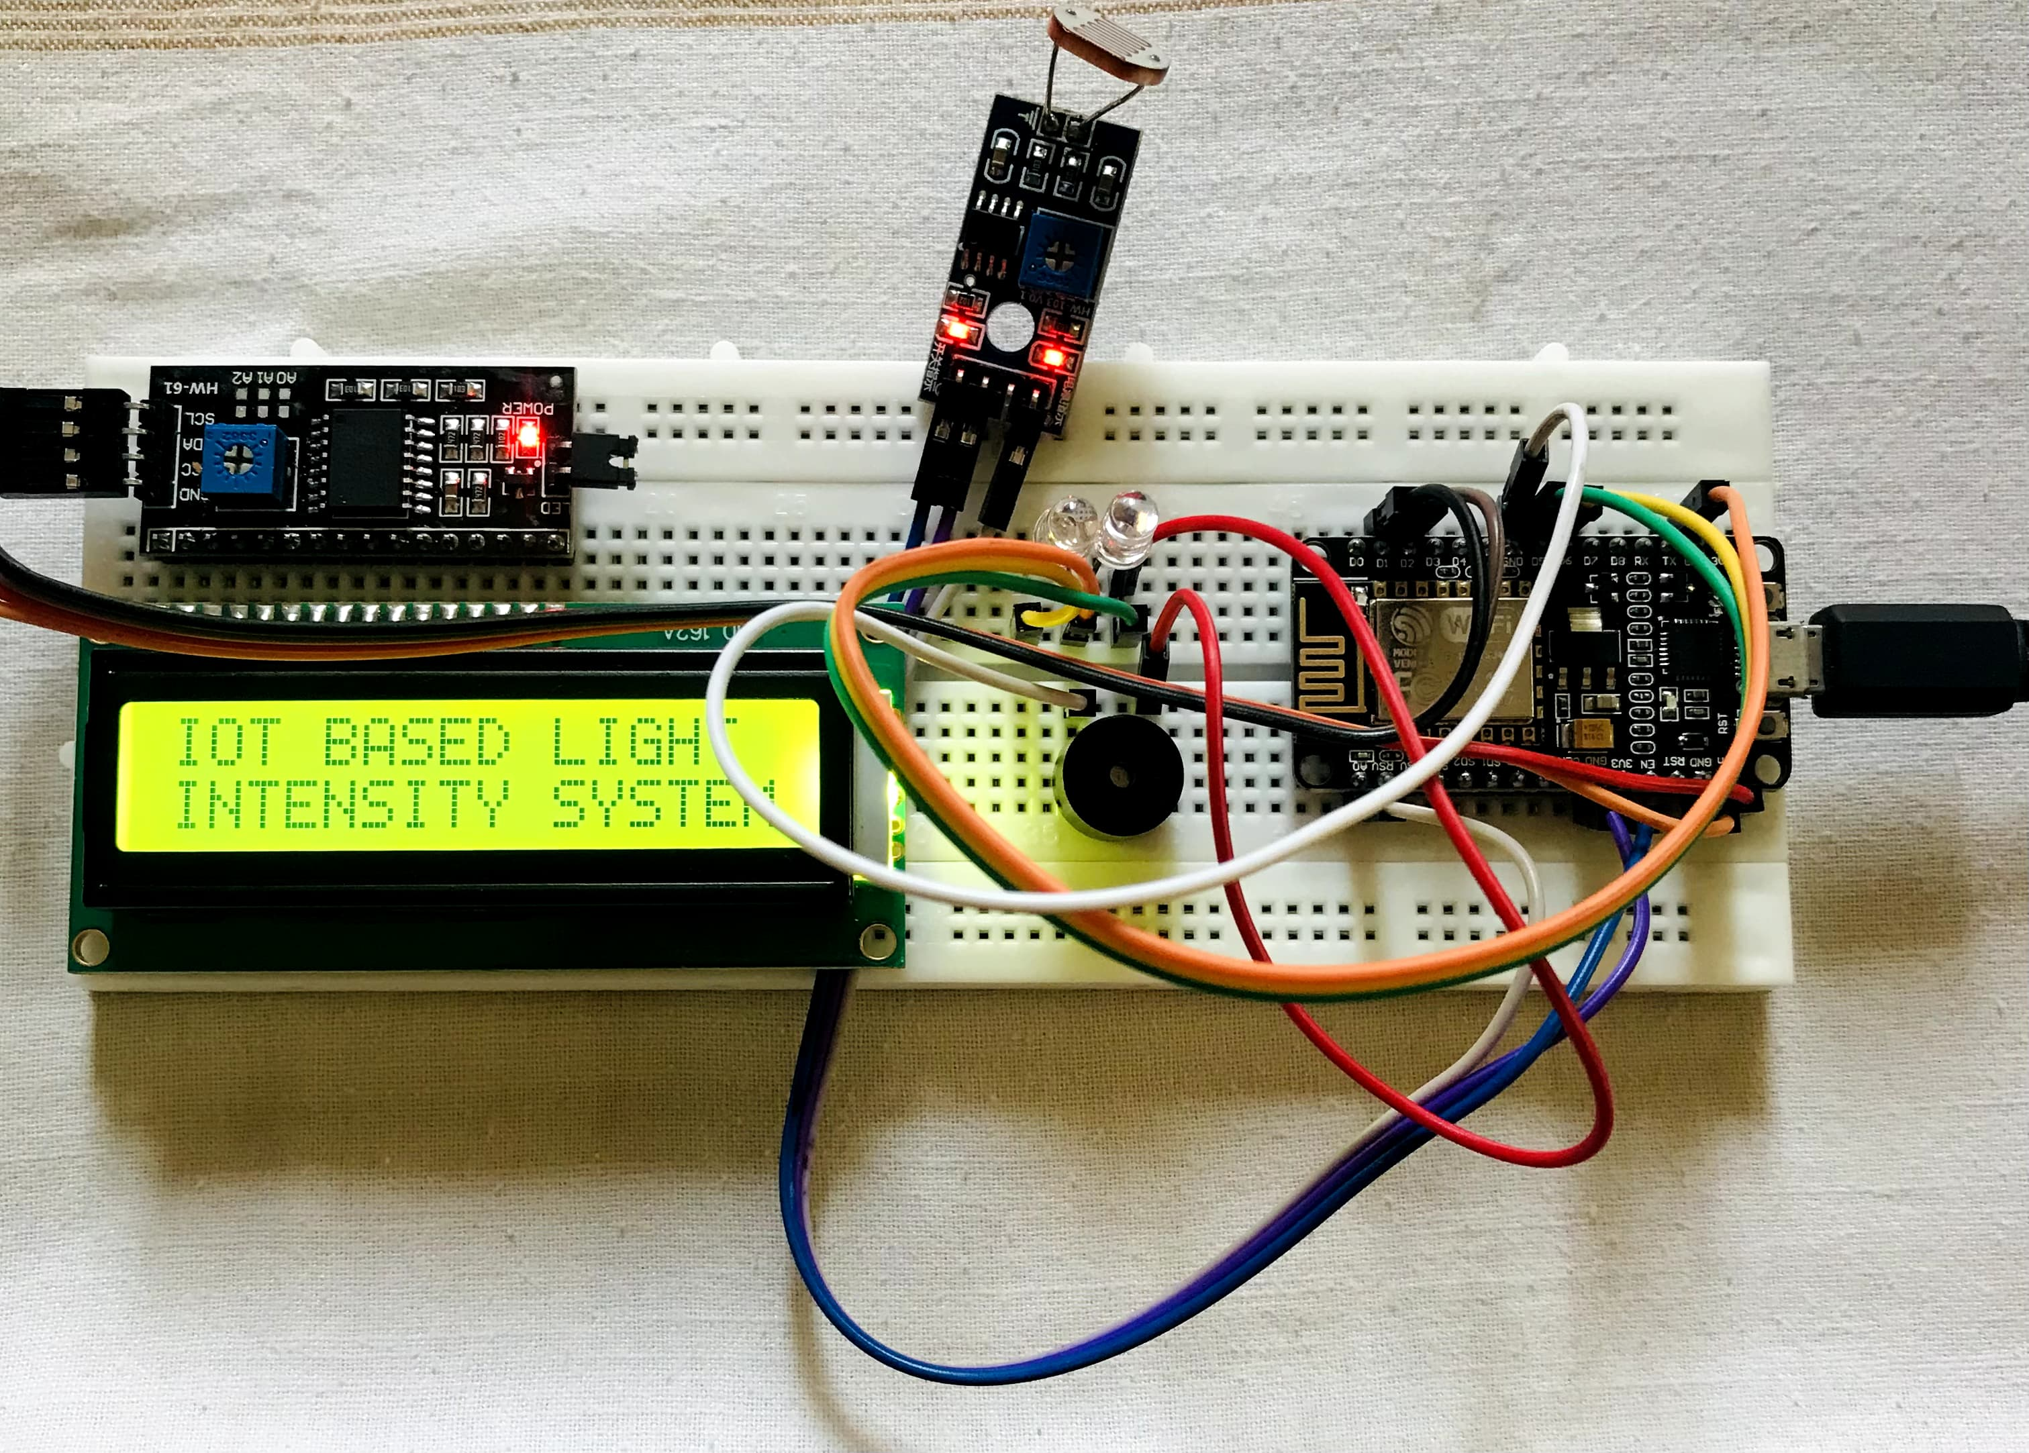
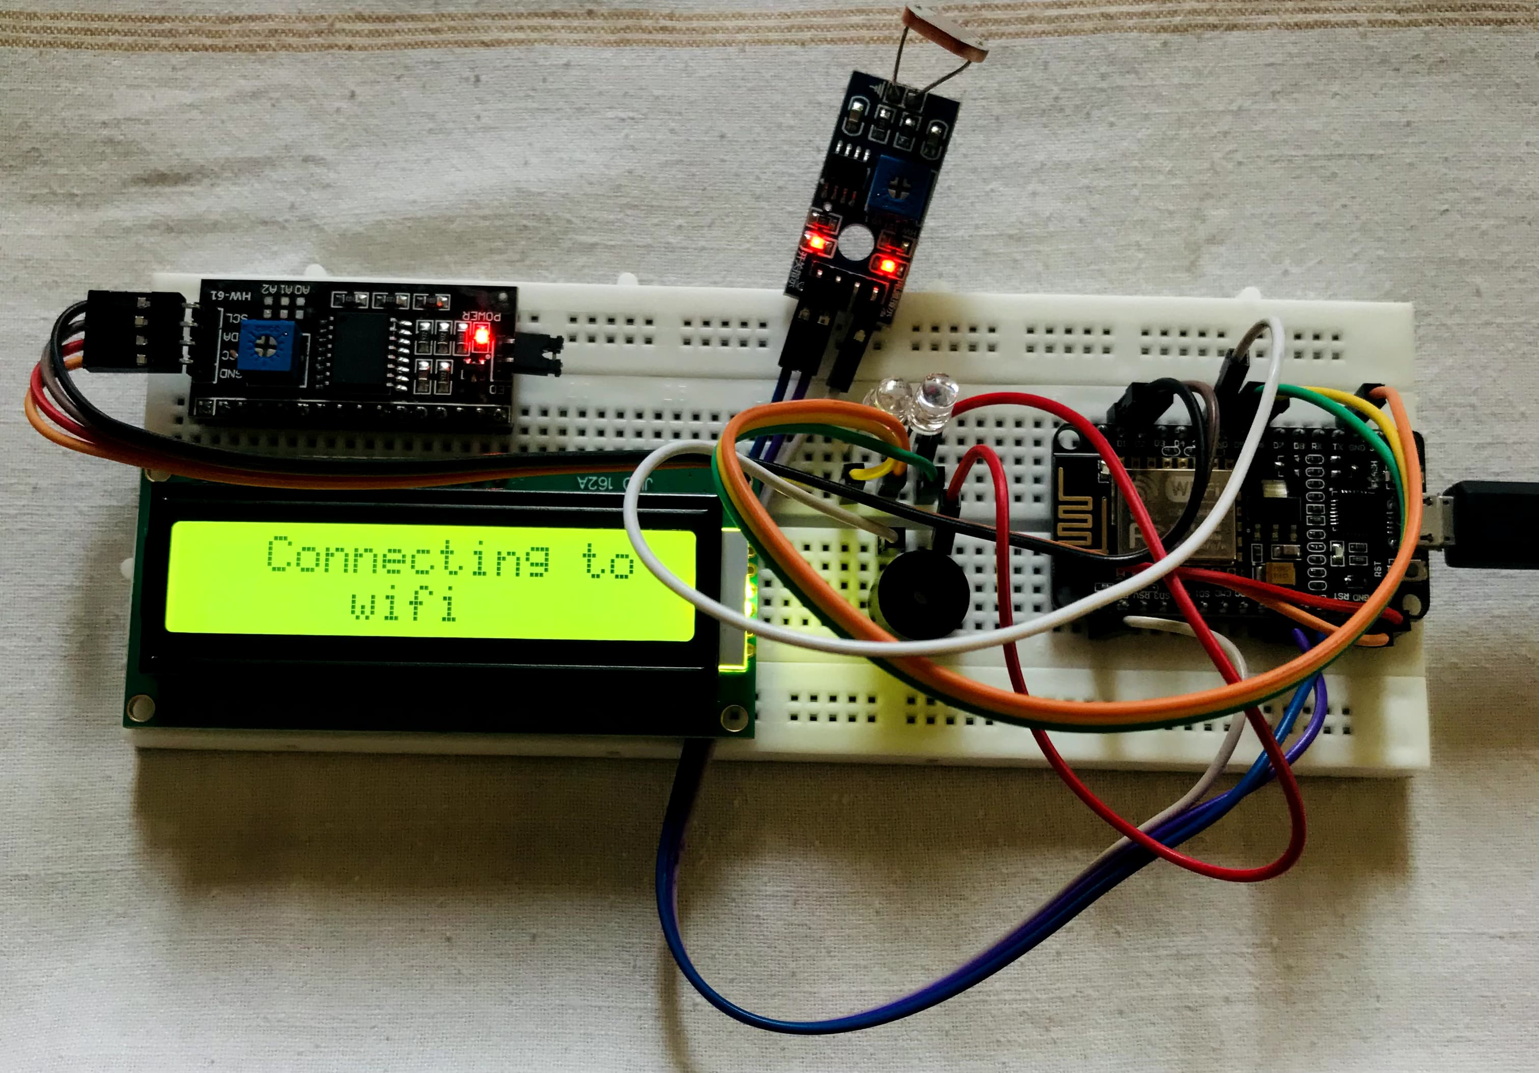
LCD AND MODULE TURNS ON
CONNECTING TO WI-FI

Slide 19
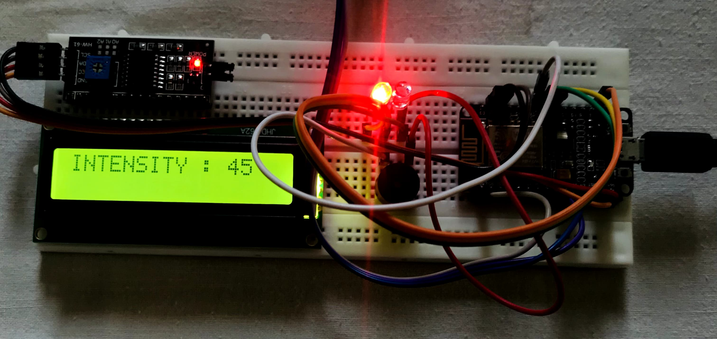
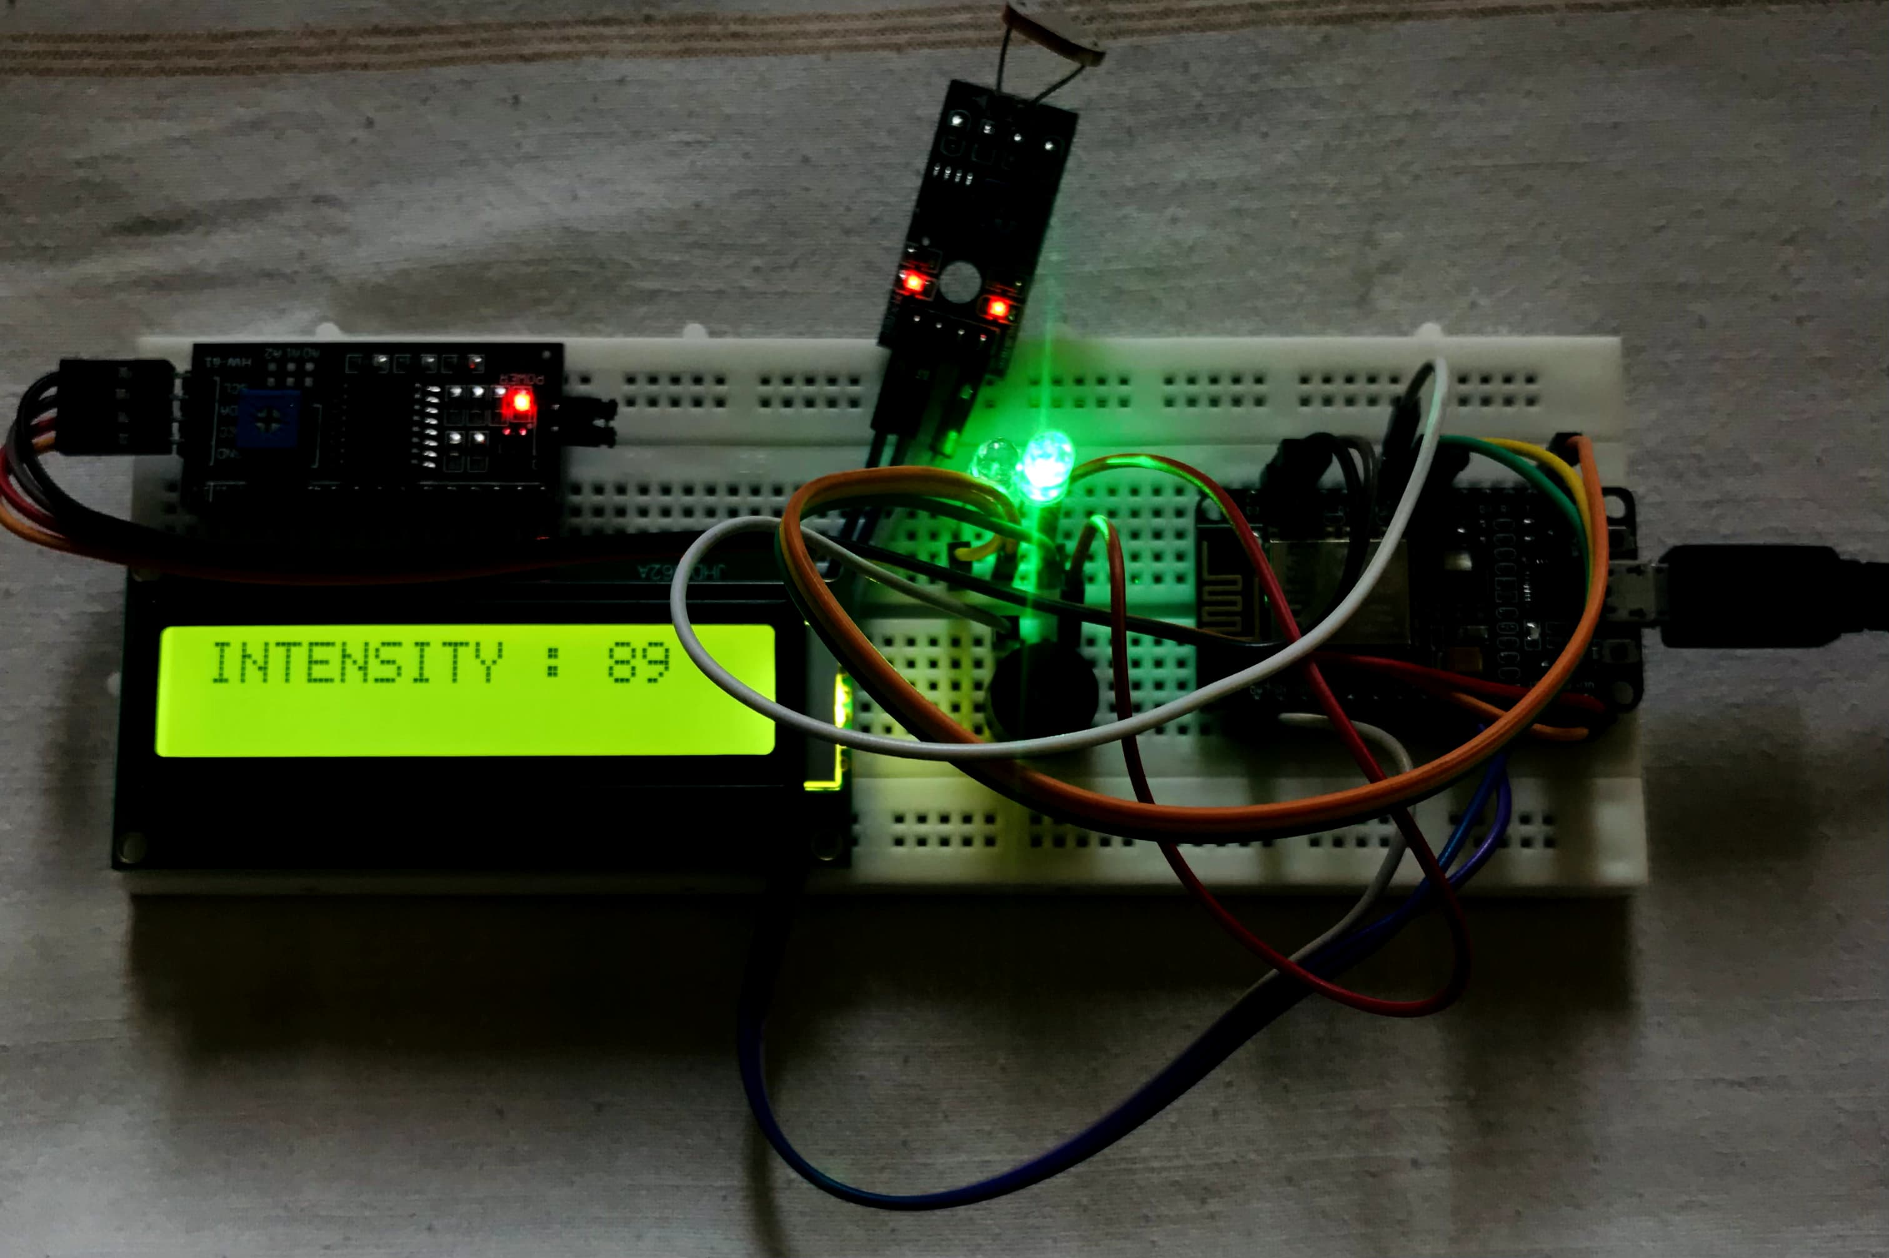
LOW INTENSITY (RED LED GLOWS)
HIGH INTENSITY (GREEN LED GLOWS)

Slide 20
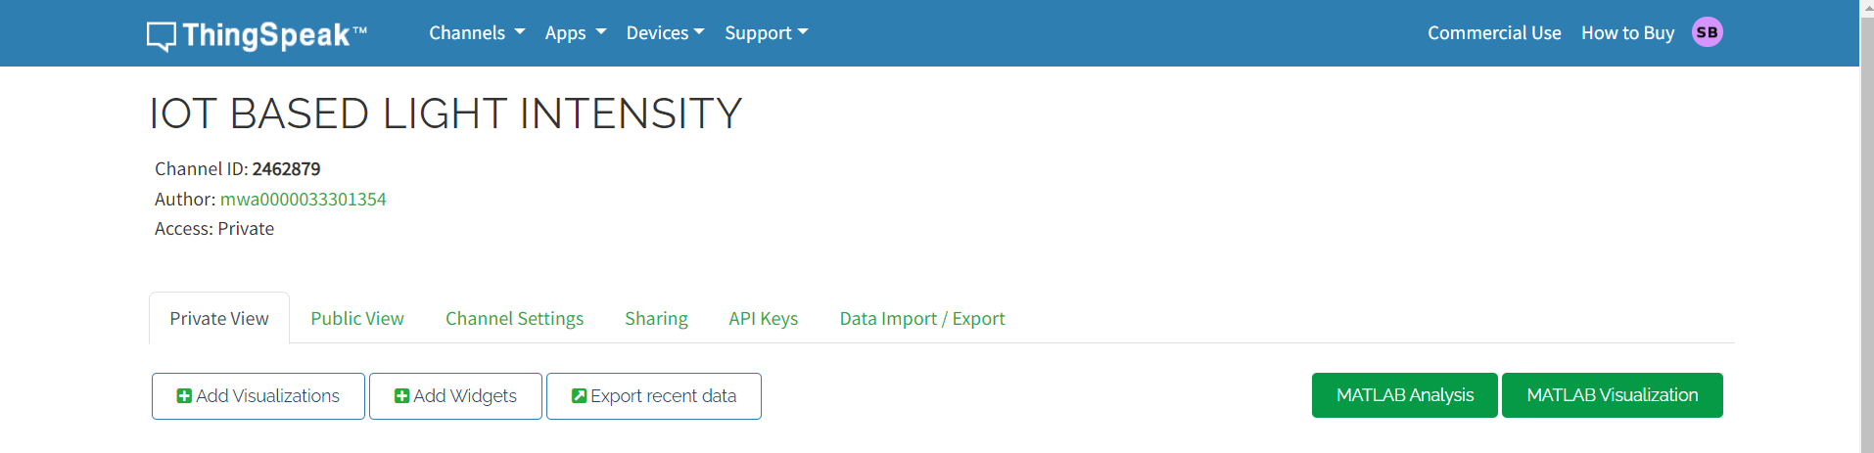
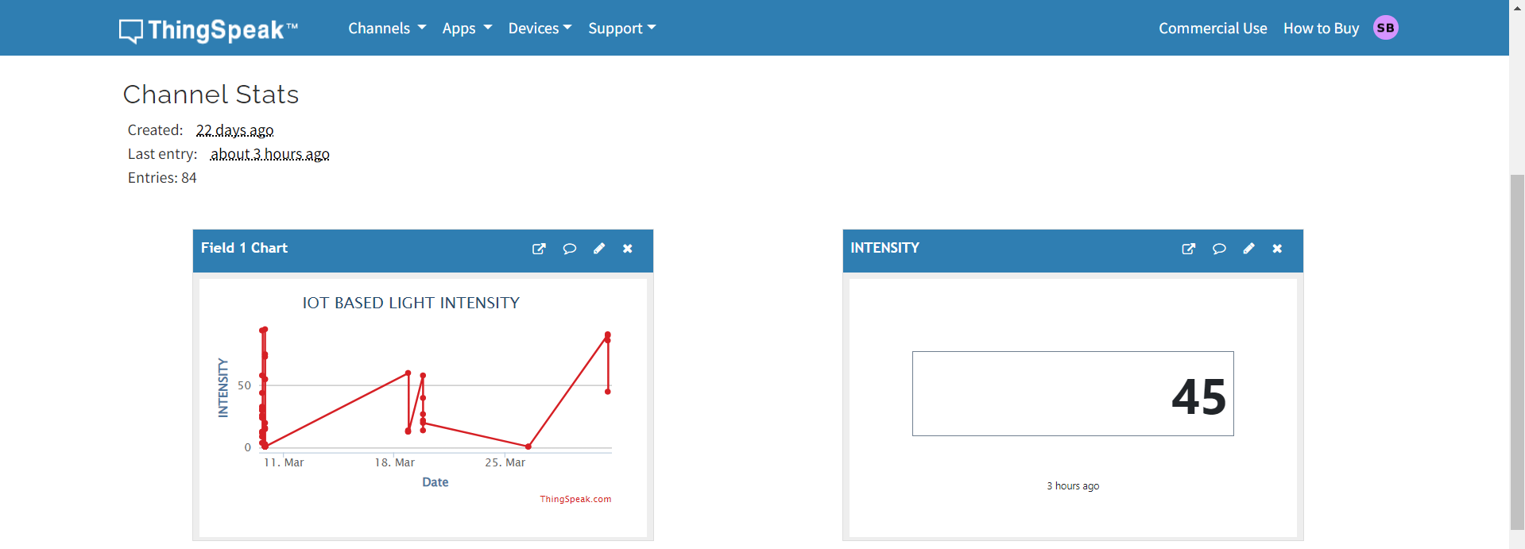

Slide 21
CONCLUSION
In conclusion, the project successfully demonstrated the practical application of ESP8266 module coupled with LCD, LEDs, and a buzzer to measure light intensity.
By integrating these components, we achieved a versatile system capable of accurately monitoring ambient light levels and providing visual and auditory feedback accordingly.
This project not only showcases the capabilities of ESP8266 in IoT applications but also highlights the importance of sensor integration for real-time environmental monitoring.
Moving forward, further enhancements such as remote data logging, wireless connectivity, and integration with other smart devices can be explored to extend the functionality and utility of the system.
Overall, the project lays a solid foundation for future developments in the field of light intensity measurement and IoT-based solutions.

Slide 22
THANK YOU

